Slide 1


SCRUM Master
By warrios team

Slide 2


Our Team
Monafh Altmimi
Mona Alqaisi
Reem Alqahatni
Bader Alghamdi
Ahmed Asiri
Haneen Alkhulaiy
Manar Alolasi

Slide 3
Scrum is a lightweight framework that helps people, teams and organizations generate value through adaptive solutions for complex problems.
A Scrum Master is a professional who leads a team using Agile project management through the course of a project. A Scrum Master facilitates all the communication and collaboration between leadership and team players to ensure a successful outcome.

Slide 4
Scrum Master skills
* Adaptability enables you to make changes as necessary to achieve the best possible outcome.
* Problem-solving skills help you navigate complex projects.
* Motivational skills empower you to bring out the best in your team to improve productivity.
03
02
04
01
05
* Organization skills help you manage multiple tasks, meetings, resources, and priorities.
* Communication skills allow you to collaborate effectively with team members and stakeholders.

Slide 5
Challenges faced by the Scrum Master:
01
02
-When the Scrum Master becomes dispensable.
- Scrum events not conducted properly
SCRUM
04
03
- Conflict with Product Owner
- Infighting in the team

Slide 6
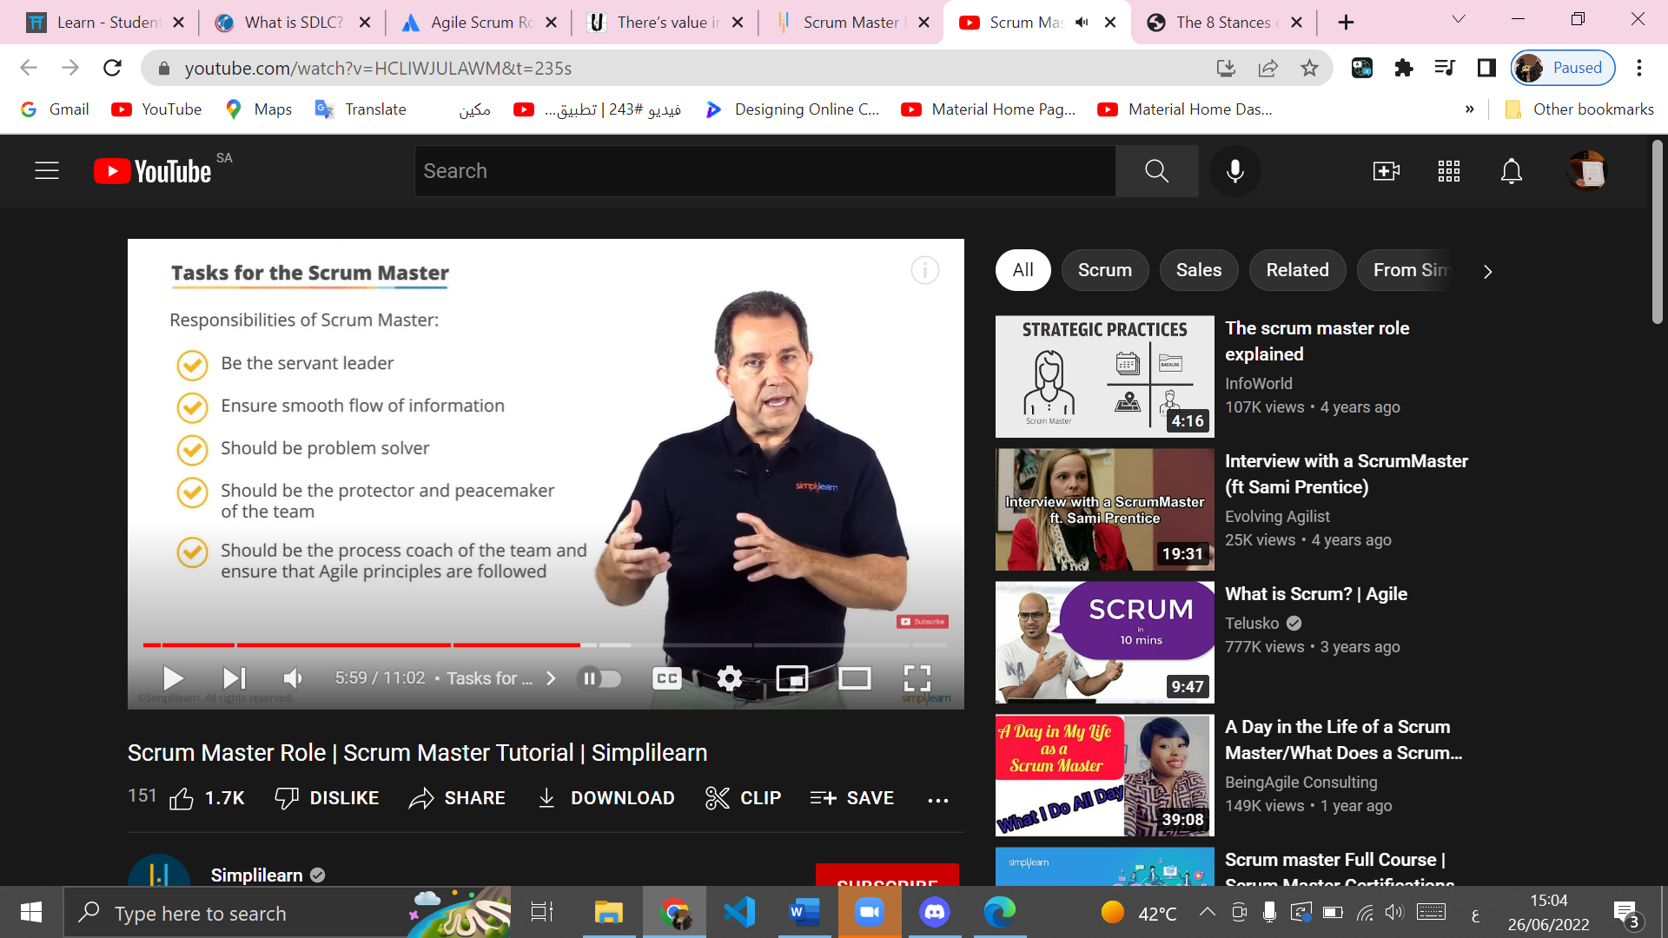

Slide 7
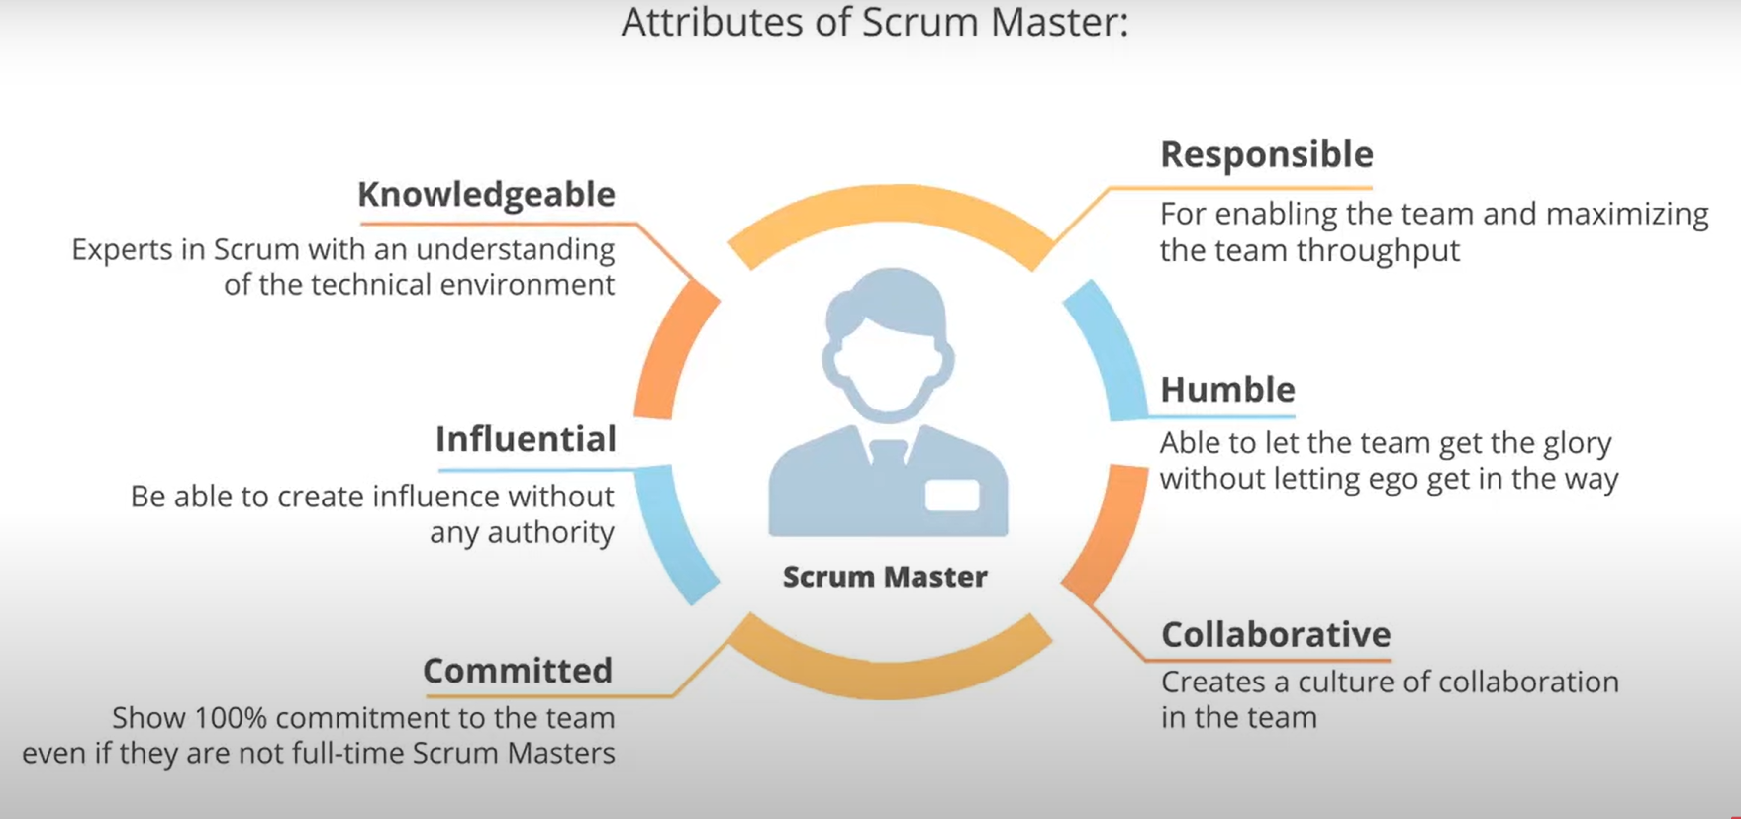

Slide 8
Thank you

